Slide 1
Employee Data Analysis using Excel
STUDENT NAME: Jenifer Edwin
REGISTER NO: 312215117
DEPARTMENT: B.Com Commerce
COLLEGE : Soka Ikeda Arts & Science

Slide 2
PROJECT TITLE
Employee Performance Analysis using Excel

Slide 3


AGENDA
Problem Statement
Project Overview
End Users
Our Solution and Proposition
Dataset Description
Modelling Approach
Results and Discussion
Conclusion
3/21/2024 Annual Review

Slide 4

PROBLEM STATEMENT
Objective: To analyze employee performance data to identify high performers, areas for improvement, and overall trends within the organization.
Background: The company has collected performance data for its employees over the past year, including metrics such as productivity, attendance, goal achievement, and feedback scores. This data is stored in Excel spreadsheets.

Slide 5

PROJECT OVERVIEW
To create a comprehensive Excel-based dashboard to analyze and visualize employee performance data, enabling HR and management to make data-driven decisions.

Slide 6

WHO ARE THE END USERS?
HR managers
Team leaders
Department heads
Stakeholders

Slide 7

OUR SOLUTION AND ITS VALUE PROPOSITION
Our solution utilizes Excel for employee performance analysis, offering in-depth insights into productivity and efficiency.
The value proposition includes empowering decision-makers with data-driven insights for resource optimization and performance enhancement.
The solution streamlines performance evaluation, facilitates informed decision-making, and drives continuous improvement within the organization.

Slide 8
Dataset Description
We took the employee datas from kaggle website.
We have 26 features totally.But, We used only 9 of the features.
We entered the name of the employees in Alphabetical order. And we also enterd the employee type in Alphabetical order.
We entered the performance level of the employee in Numerical value.
We entered the gender of the employees as Male/Female.
We entered the data of employee rating in Numerical value.
We entered the Business unit in Alphabetical order.

Slide 9

THE "WOW" IN OUR SOLUTION
PERFORMANCE LEVEL =IFS(Z8>=5,”VERY
HIGH”,Z8>=4,”HIGH”,Z8>=3,”MED”,TRUE,”LOW”)
3/21/2024 Annual Review
9

Slide 10
MODELLING
Regression Analysis: To identify the relationship between employee performance and various factors such as training, experience, and job satisfaction.
Clustering Analysis: To group employees with similar performance characteristics, helping to identify trends and patterns.
Decision Trees: To create a predictive model for employee turnover or performance, based on factors like engagement, satisfaction, and management support.
Random Forest: To improve the accuracy of predictions by combining multiple decision trees.
10

Slide 11
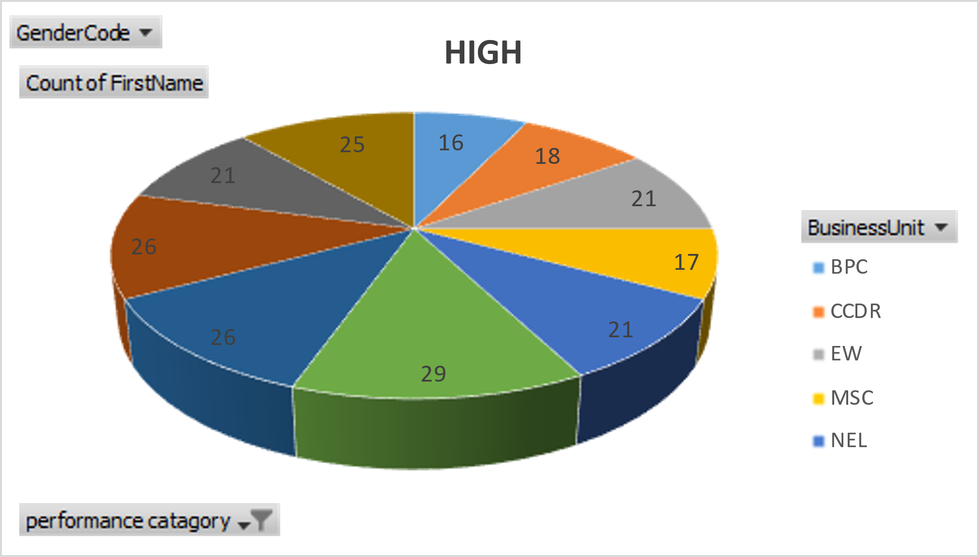
RESULTS
11

Slide 12
conclusion
Our approach to employee performance analysis using Excel offers a robust solution for optimizing workforce efficiency. By harnessing the power of Excel, we provide key insights that empower decision-makers with data-driven information to drive productivity improvements.

